Slide 1
VERBALIZED MACHINE LEARNING:
REVISITING MACHINE LEARNING WITH LANGUAGE MODELS
Li Changshi
2024.11.22
Notes:
VERBALIZED MACHINE LEARNING:
REVISITING MACHINE LEARNING WITH LANGUAGE MODELS

Slide 2
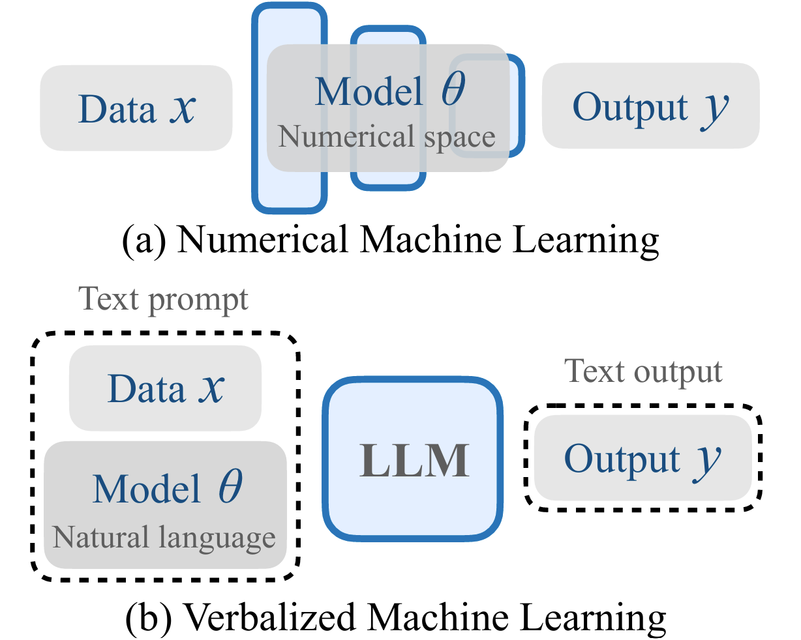
Comparison between numerical machine learning and VML

Slide 3
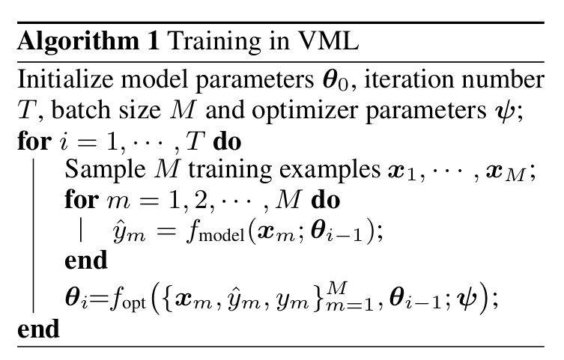
Training in VML

Slide 4
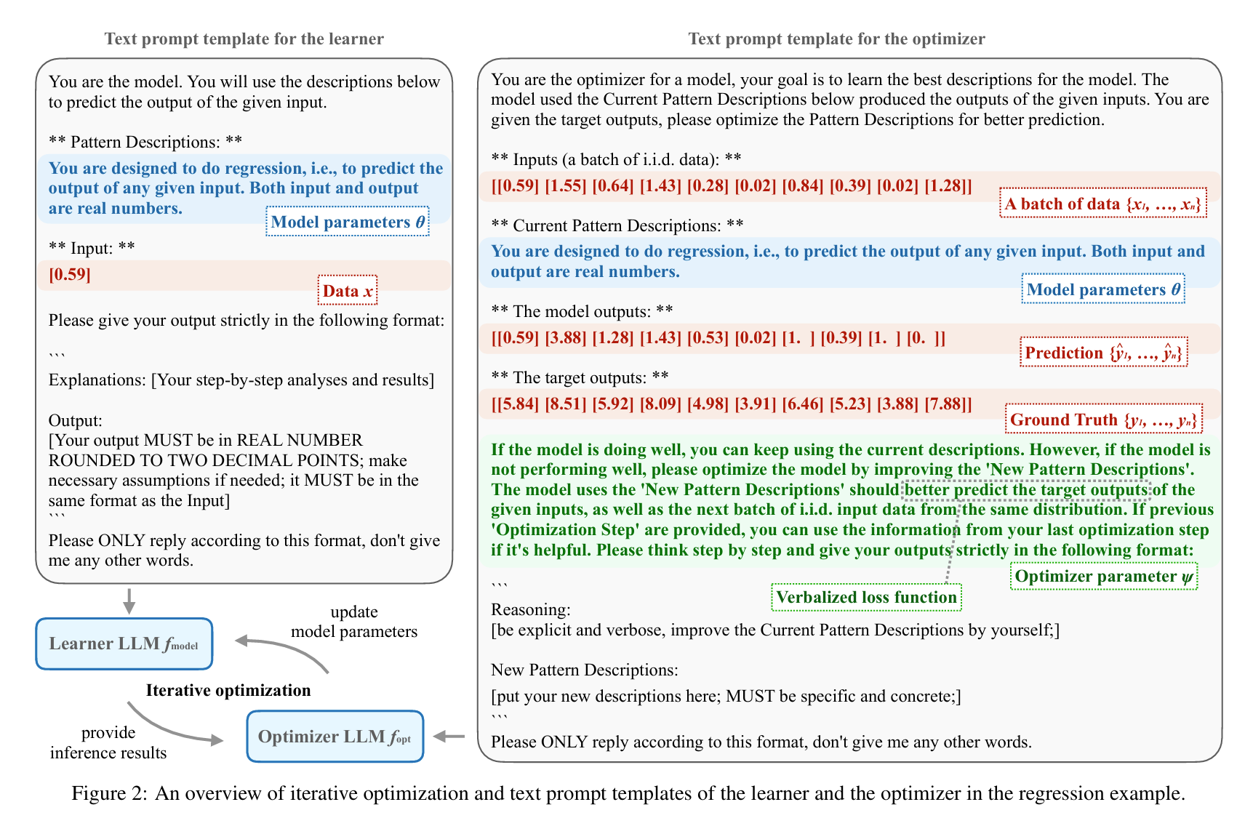

Slide 5
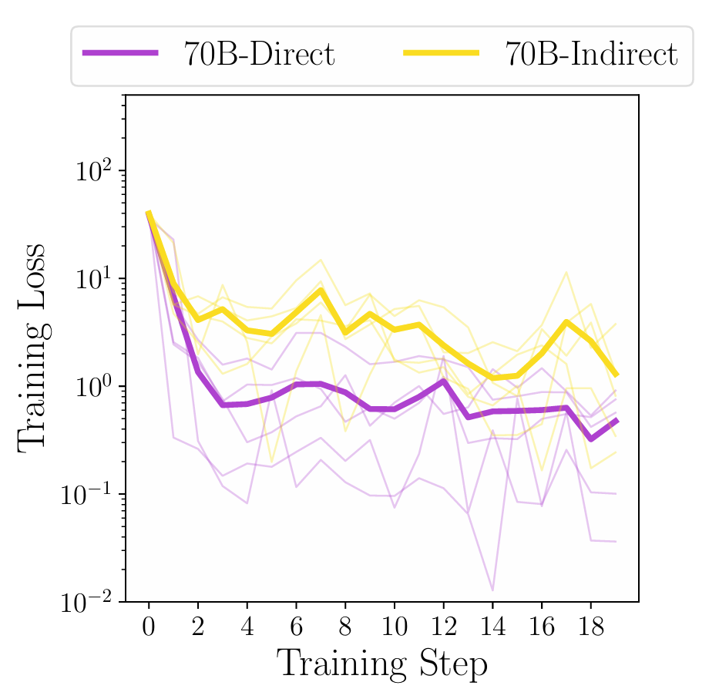
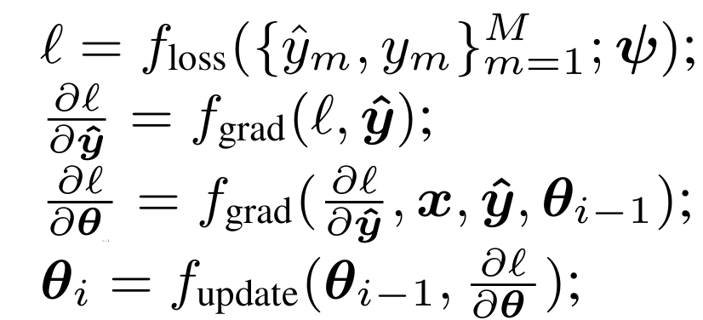
Different optimizer parameterizations
The reason can be there are 3 more prompt templates to design, which is harder than designing just one, and has a higher risk of losing information in the pipeline.
Direct parameterization
Indirect parameterization
textual gradients (Reid Pryzant et.al. 2023; Mert Yuksekgonul et.al. 2024)

Slide 6
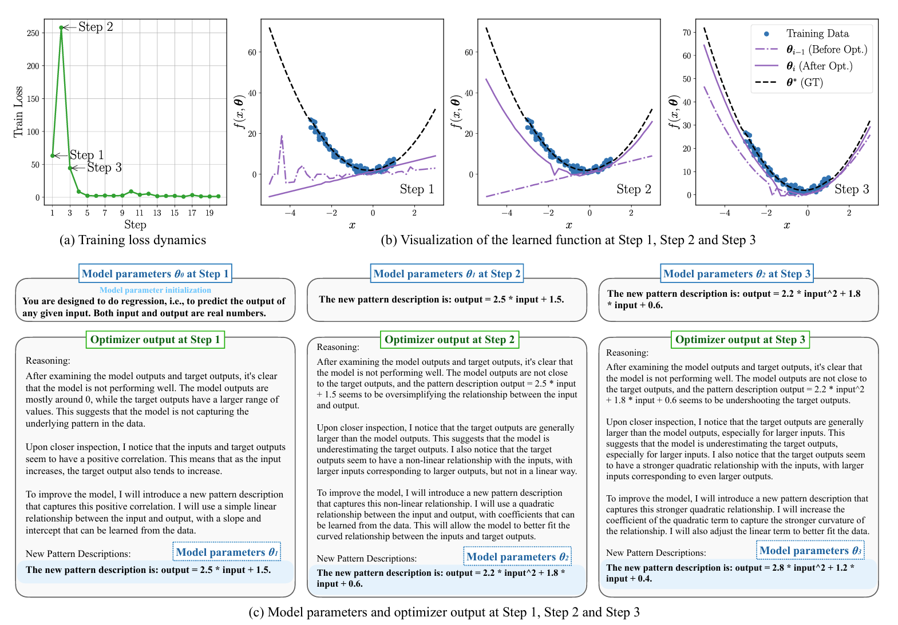

Slide 7
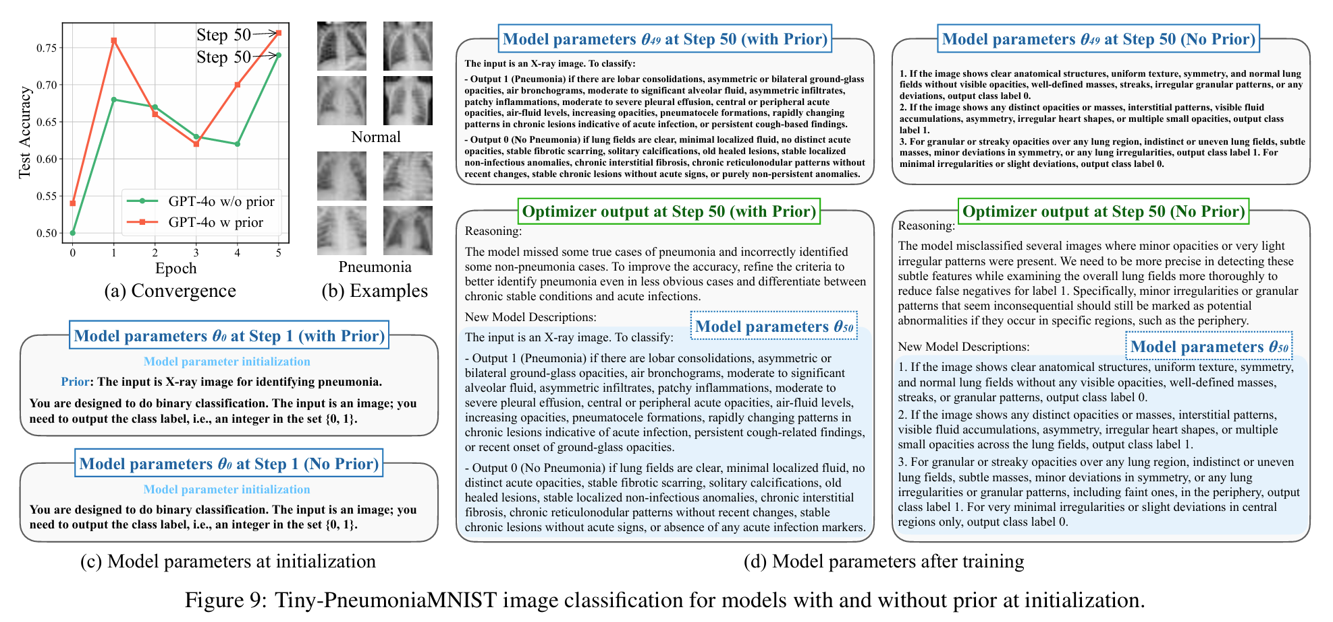

Slide 8
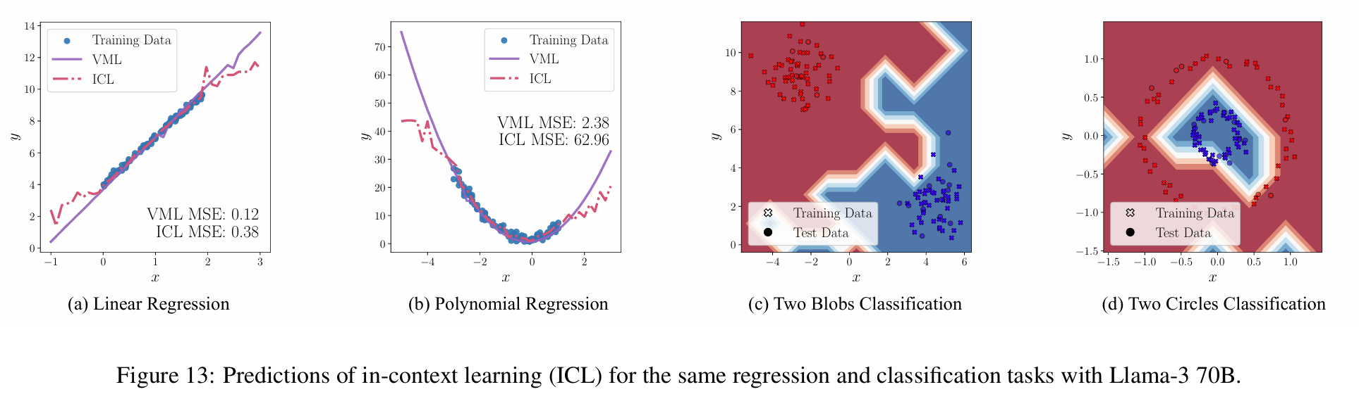
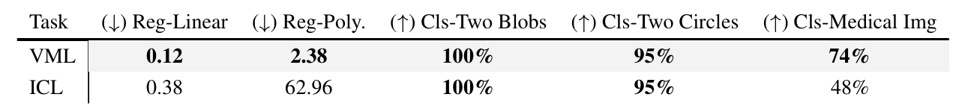
Quantitative comparison to in-context learning
Notes:
We provide the entire training set as in-context examples, and query the individual test data independently.

Slide 9
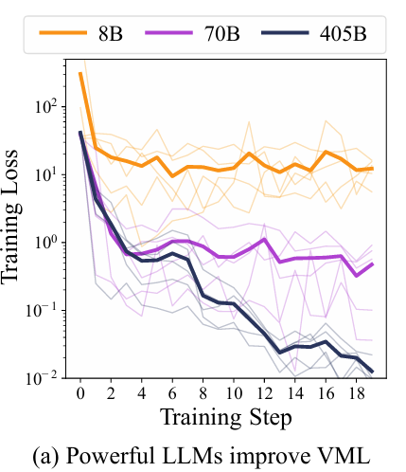
Scaling effect with stronger LLMs.
stronger LLMs(e.g.,405B) learn faster and achieve lower loss in the linear regression setting.

Slide 10
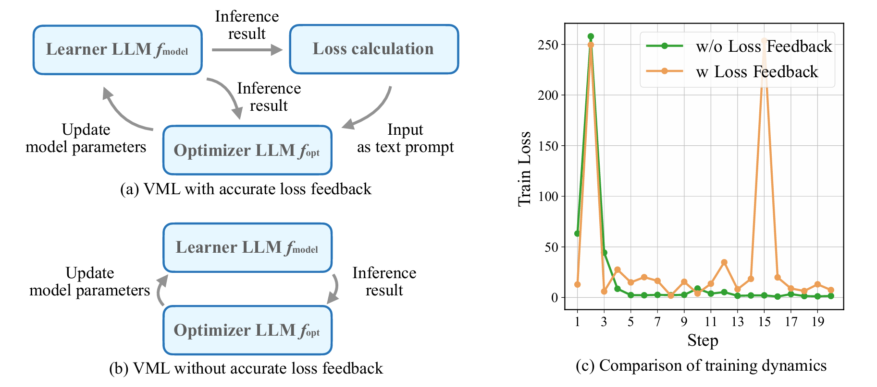
EFFECT OF ACCURATE LOSS FEEDBACK

Slide 11
EFFECT OF ACCURATE LOSS FEEDBACK
Having such accurate loss feedback might not help, and might even decrease the performance in this scenario.
As the exact form of the loss function can be fed to LLM easily, the LLM might spend additional efforts to estimate the exact form of the loss function, which makes the convergence even more difficult.
Finding
Verbalized loss function (i.e., using natural language to explain the target of the loss function) works better in the VML framework.
Reason
Conclusion

Slide 12
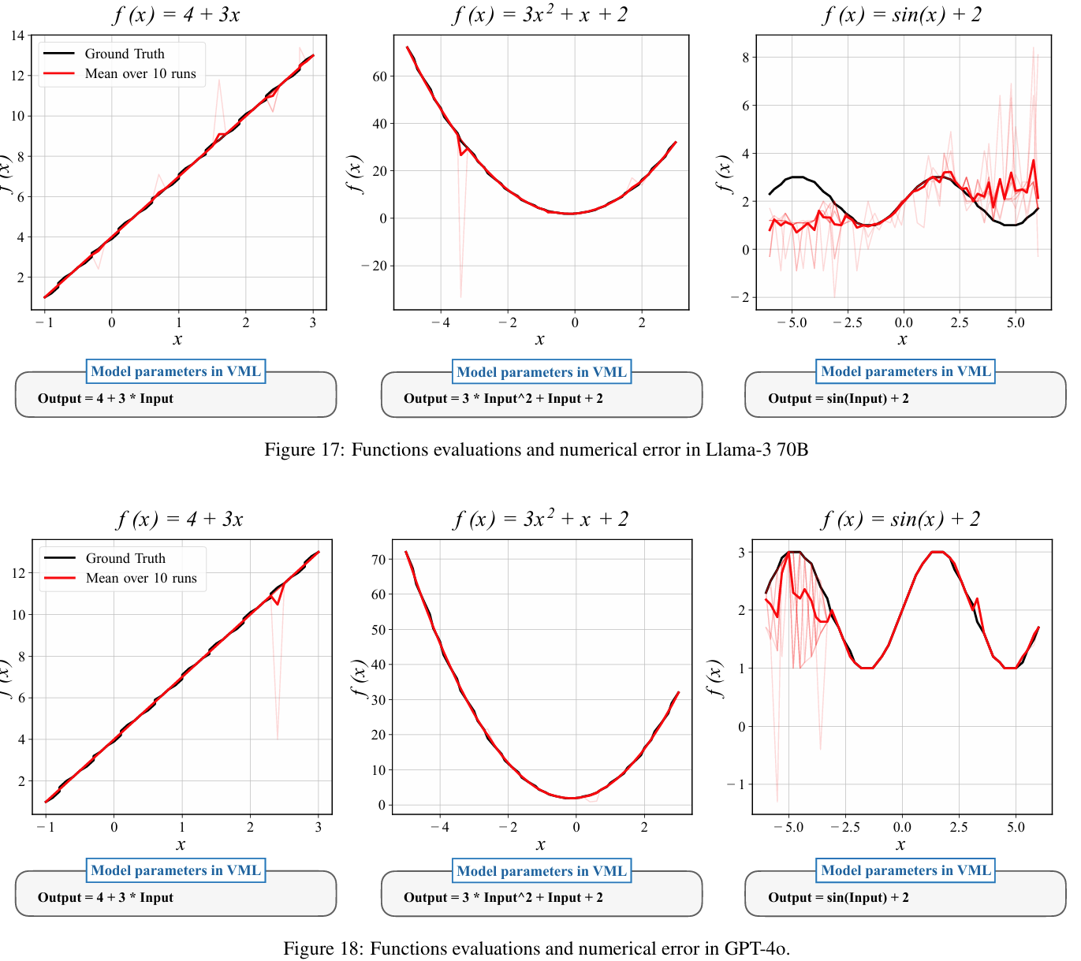
NUMERICAL ERROR OF LLMS IN REPRESENTING SYMBOLIC FUNCTIONS

Slide 13
Conclusion
discrete: the natural language space is discrete;
(2) sequential: the natural language space is sequential, and the next word is dependent on its previous words.
(3) human-interpretable: the natural language that characterizes the model is human-interpretable.

